Slide 1
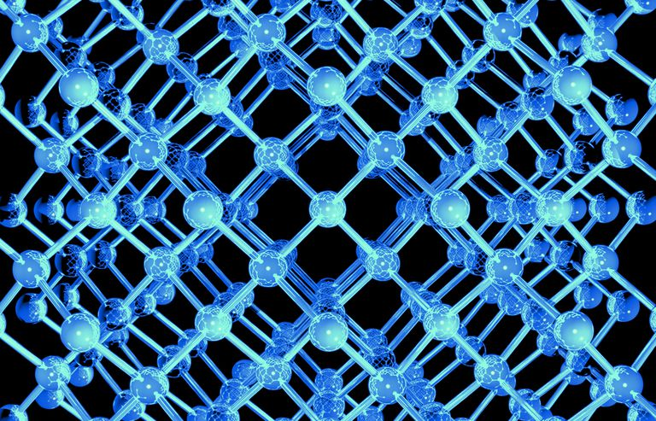
Ionic bonding: formulae and naming

Slide 2

Ionic bonding: Lewis structures
Lewis dot diagram representation of the electron transfer between Magnesium and Oxygen to form Magnesium oxide
Things to note:
The magnesium ion has no brackets or electrons but does have a charge
The oxide ion has brackets (showing that the valance electrons are NOT being shared - they are only associated with the oxide ion), shows the electrons and the charge

Slide 3
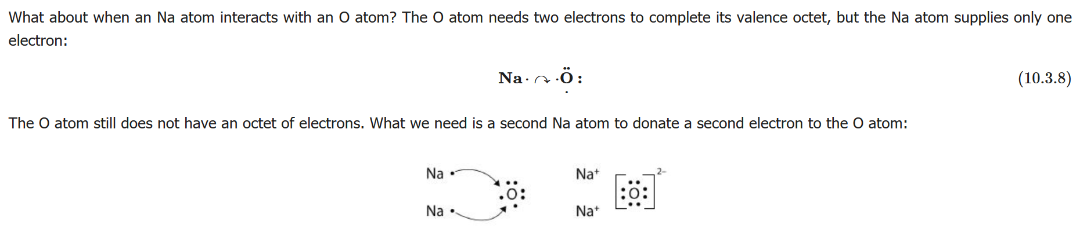
Ionic bonding: Lewis structures
Try the reaction between sodium and oxygen
The sodium can only supply one electron, so the oxygen atoms still doesn’t have an octet of electrons. So, two sodium atoms are required.

Slide 4
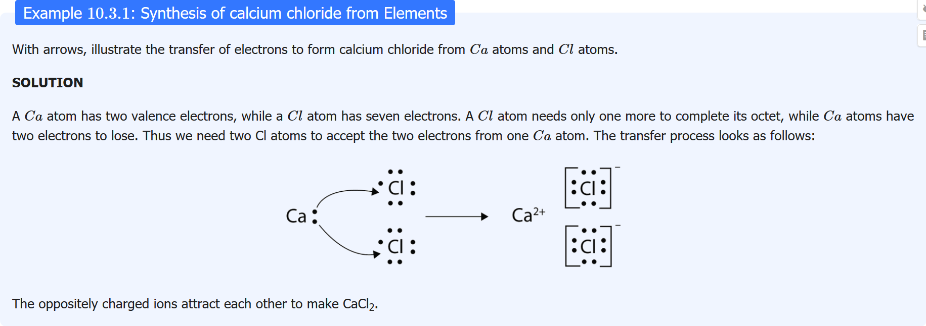
Ionic bonding: Practice

Slide 5
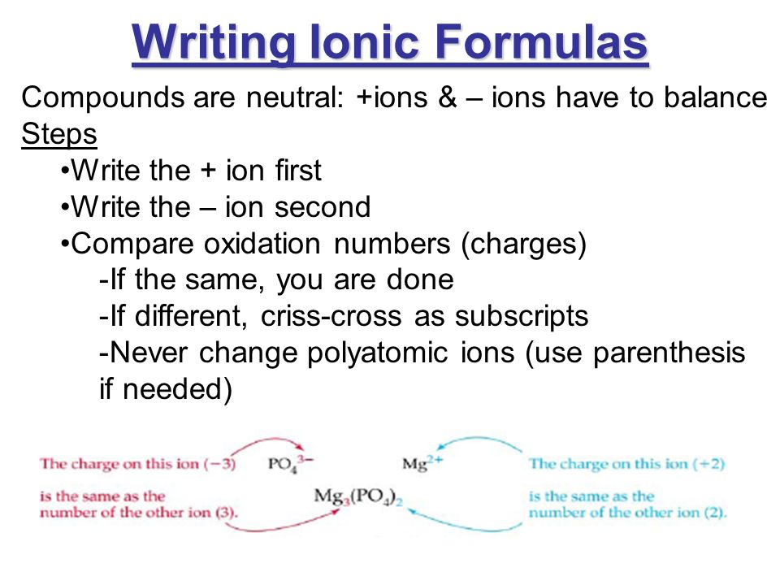
Ionic bonding: Writing Ionic formula

Slide 6
Ionic bonding: Naming
Monoatomic cations:
Same name as the metal atom eg Na⁺ sodium ion, Ca²⁺ calcium ion
Metals that can form more then one type of ion we add a number. For example, Cu⁺ is copper(I) and Cu²⁺ is copper(II).
Monoatomic anions:
We add “ide” to the name. For example, chlorine (Cl) becomes chloride (Cl⁻), oxygen (O) becomes oxide (O²⁻), sulfur (S) becomes sulfide (S²⁻).

Slide 7
Ionic bonding: Naming
Polyatomic cations and anions
Names cannot be predicted from the formula
Need to use Appendix 2 and learn the ones that are required for Year 11 and 12 chemistry

Slide 8
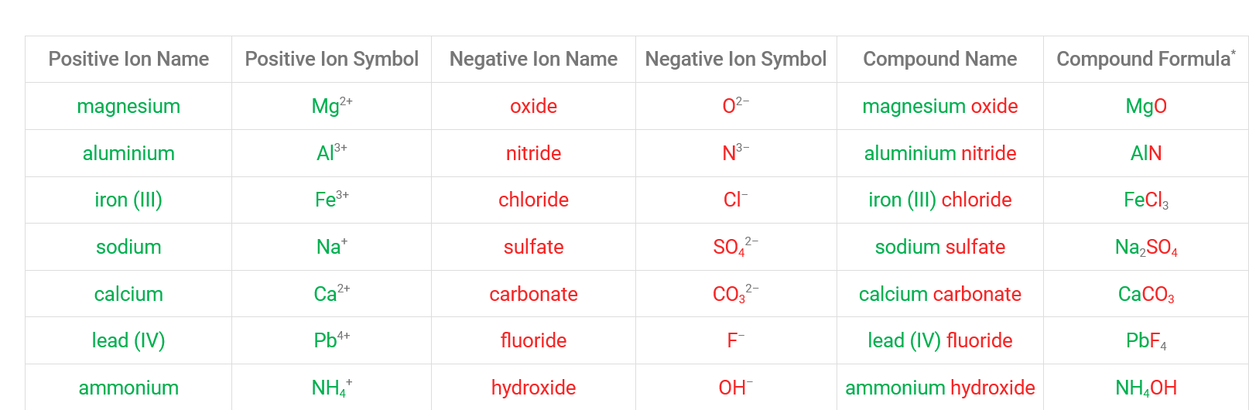
Ionic bonding: Naming
Naming ionic compounds:
Write the name of the cation first
Followed by the name of the anion

Slide 9
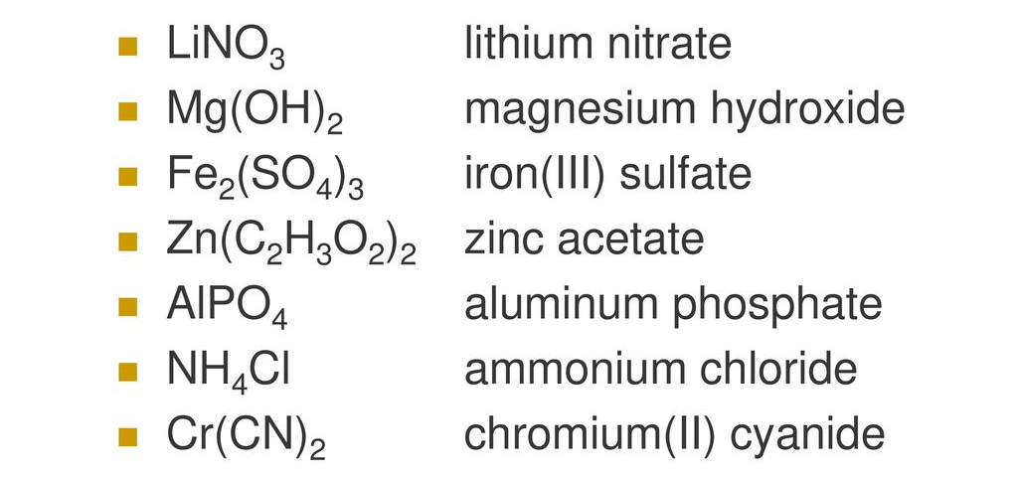
Ionic bonding: Practice

Slide 10
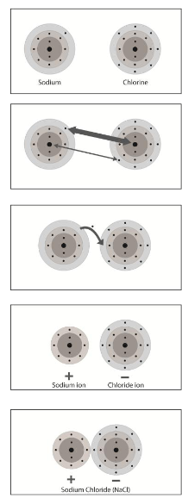
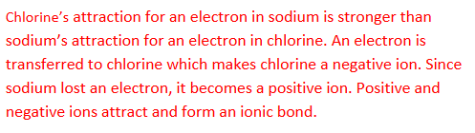
Ionic bonding: ER practice

Slide 11
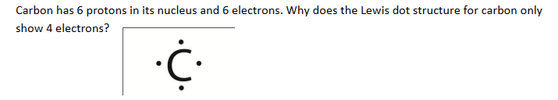

Ionic bonding: ER practice

